Slide 1
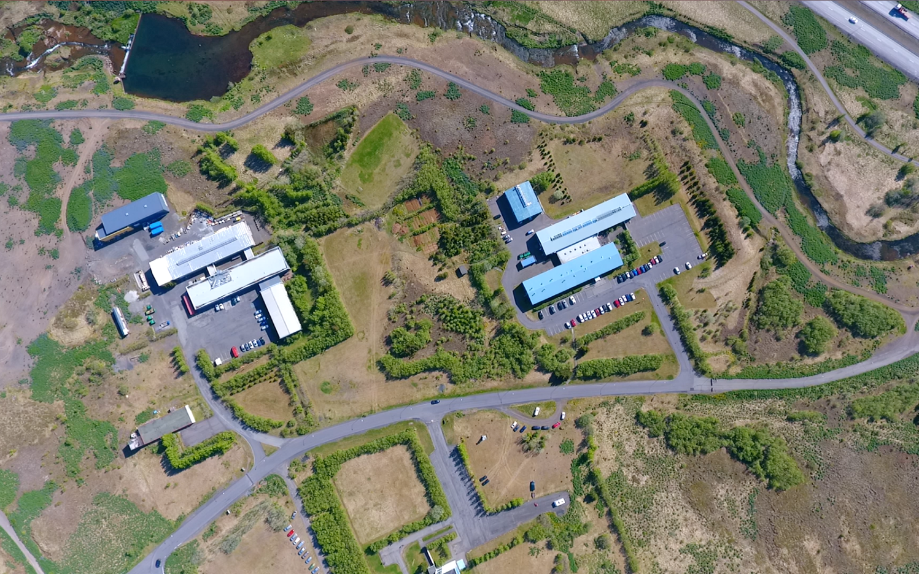

Slide 2

The partner of choice for diverse projects
Innovation Center Iceland

Slide 3
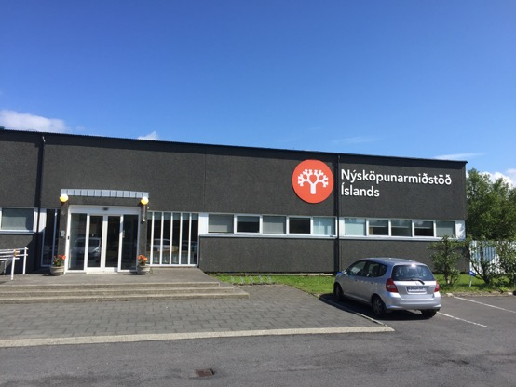
Innovation Center Iceland
A leading R&D and business support institute in Iceland
Focus on R&D, technology transfer, education, support for entrepreneurs and SMEs and consulting with the overall goal to increase innovation, productivity and competitiveness!

Slide 4
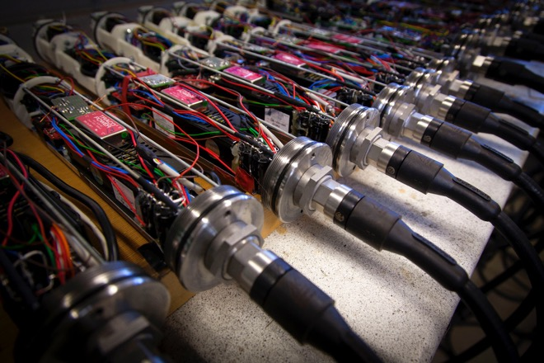
Technological Research and Consulting
Core Activites
...research and consulting in diverse fields such as nanotechnology, renewable energy and concrete rheology. Projects include applied research and testing, basic research in key areas, consultation and technology transfer.

Slide 5
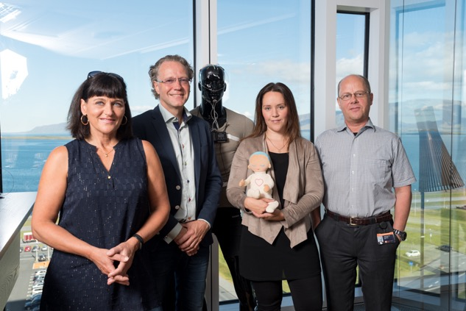
Innovation and Entrepreneur Service
Core Activities
...professional assistance to entrepreneurs in the start-up, growth and management of SMEs. Personal guidance, incubator centers, extensive internet information services, workshops, publication and courses

Slide 6





Over 90 employees in 6 locations
Sauðárkrókur
2009
Ísafjörður 2007
Akureyri 2002
Reykjavík
Vestmannaeyjar 2008

Slide 7
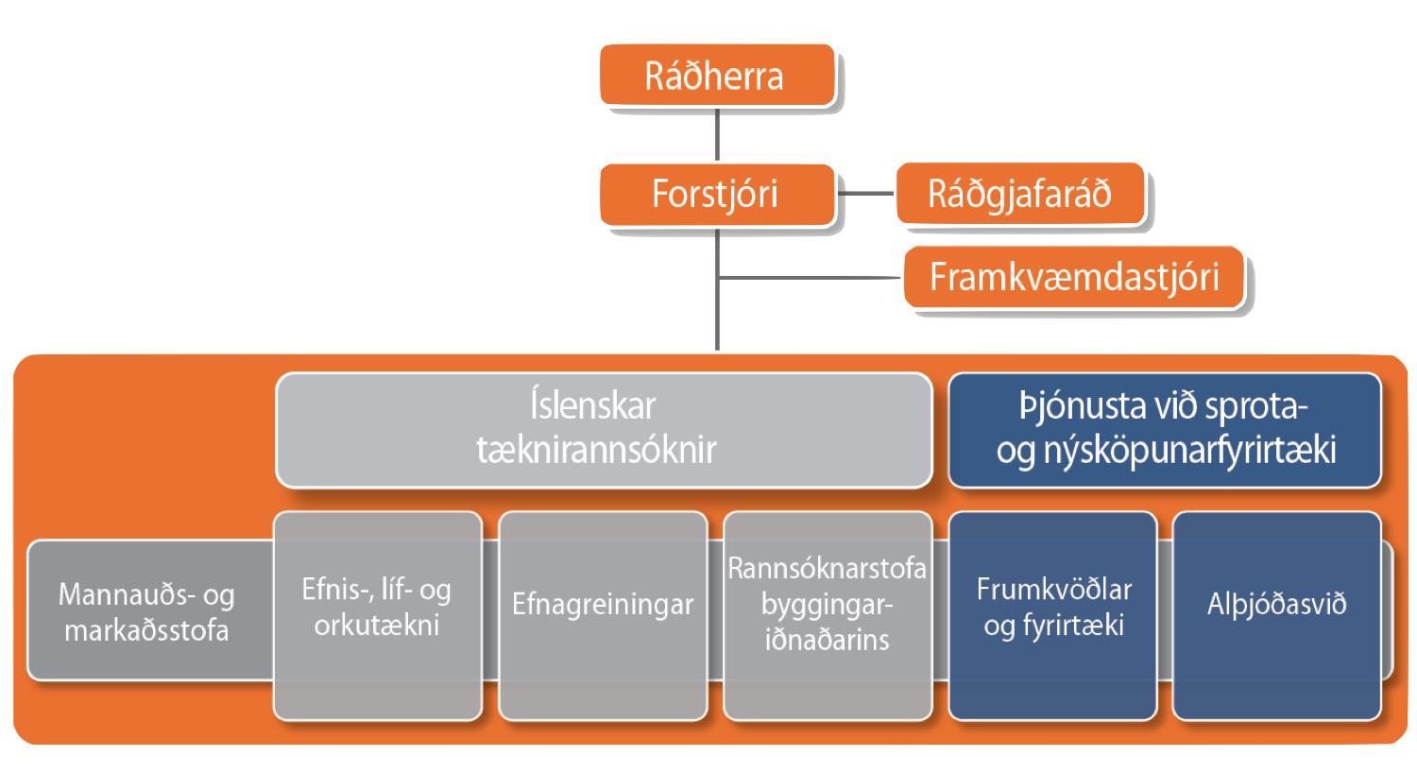
Minister of Innovation
Director General
Advisory Board
Managing Director
Icelandic Technological
Research
Innovation and Startup Services
International Division
Materials,
Biotech &
Energy
Chemical
Analysis
HR &
Marketing
Building
Research
Entrepreneurs &
SMEs

Slide 8
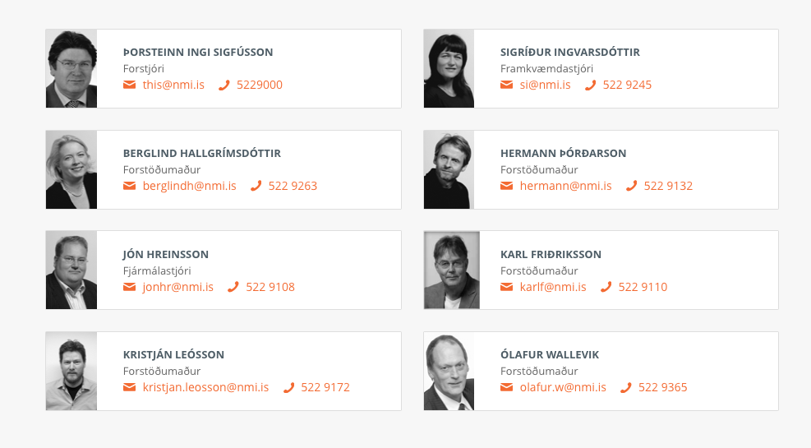
Board of Managing Directors

Slide 9
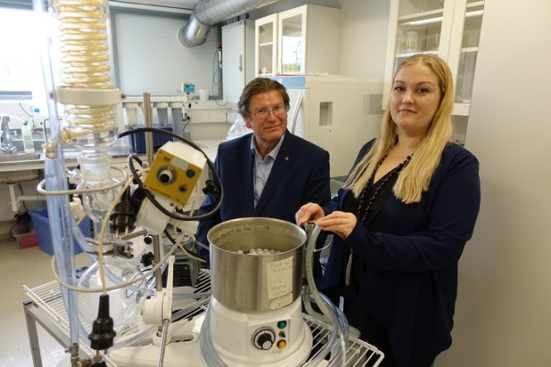
Technological Research and consulting
Applied research projects and consultation in the fields of building and structures, production, biotechnology, materials, chemical analysis, environmental and energy
Valuable experience of collaborating with businesses on the development of new technology, products and services
Contractual services of various kind; tests and analysis

Slide 10
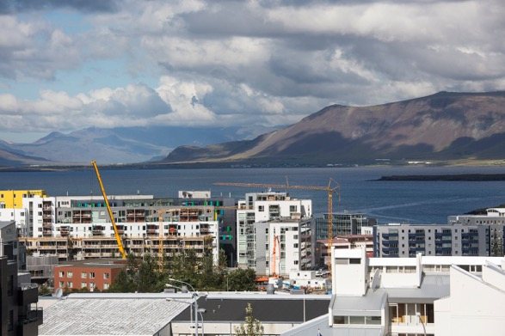
Building Research and Rheocenter
The main professional areas of the Department of Construction Research and Development are construction technology, bearing capacity, materials technology, i.e. non-metallic mineral products and other building materials, acoustic technology and surface handling.
Tasks covered by the department can be divided into the following areas:
Research projects
Research services
Publishing, presentations and education
Quality certifications and formal reports

Slide 11
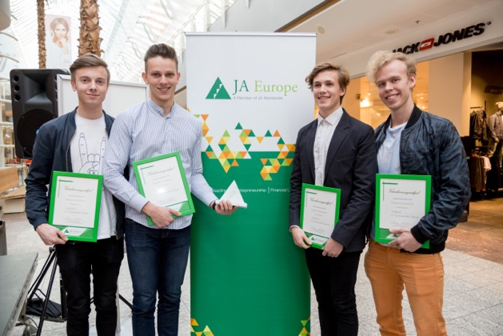
Entrepreneurs and SME services
Center of information and guidance for entrepreneurs and SMEs
Around 5.000 free support interviews annually
Support programs and grants
Workshops and courses for the general public and SMEs
Notes:
60 % of women who have finished Brautargengi are running a company
Most of the women say the programme had a big influence on their decision to start a company
The majority of the women think they are better administrators.

Slide 12
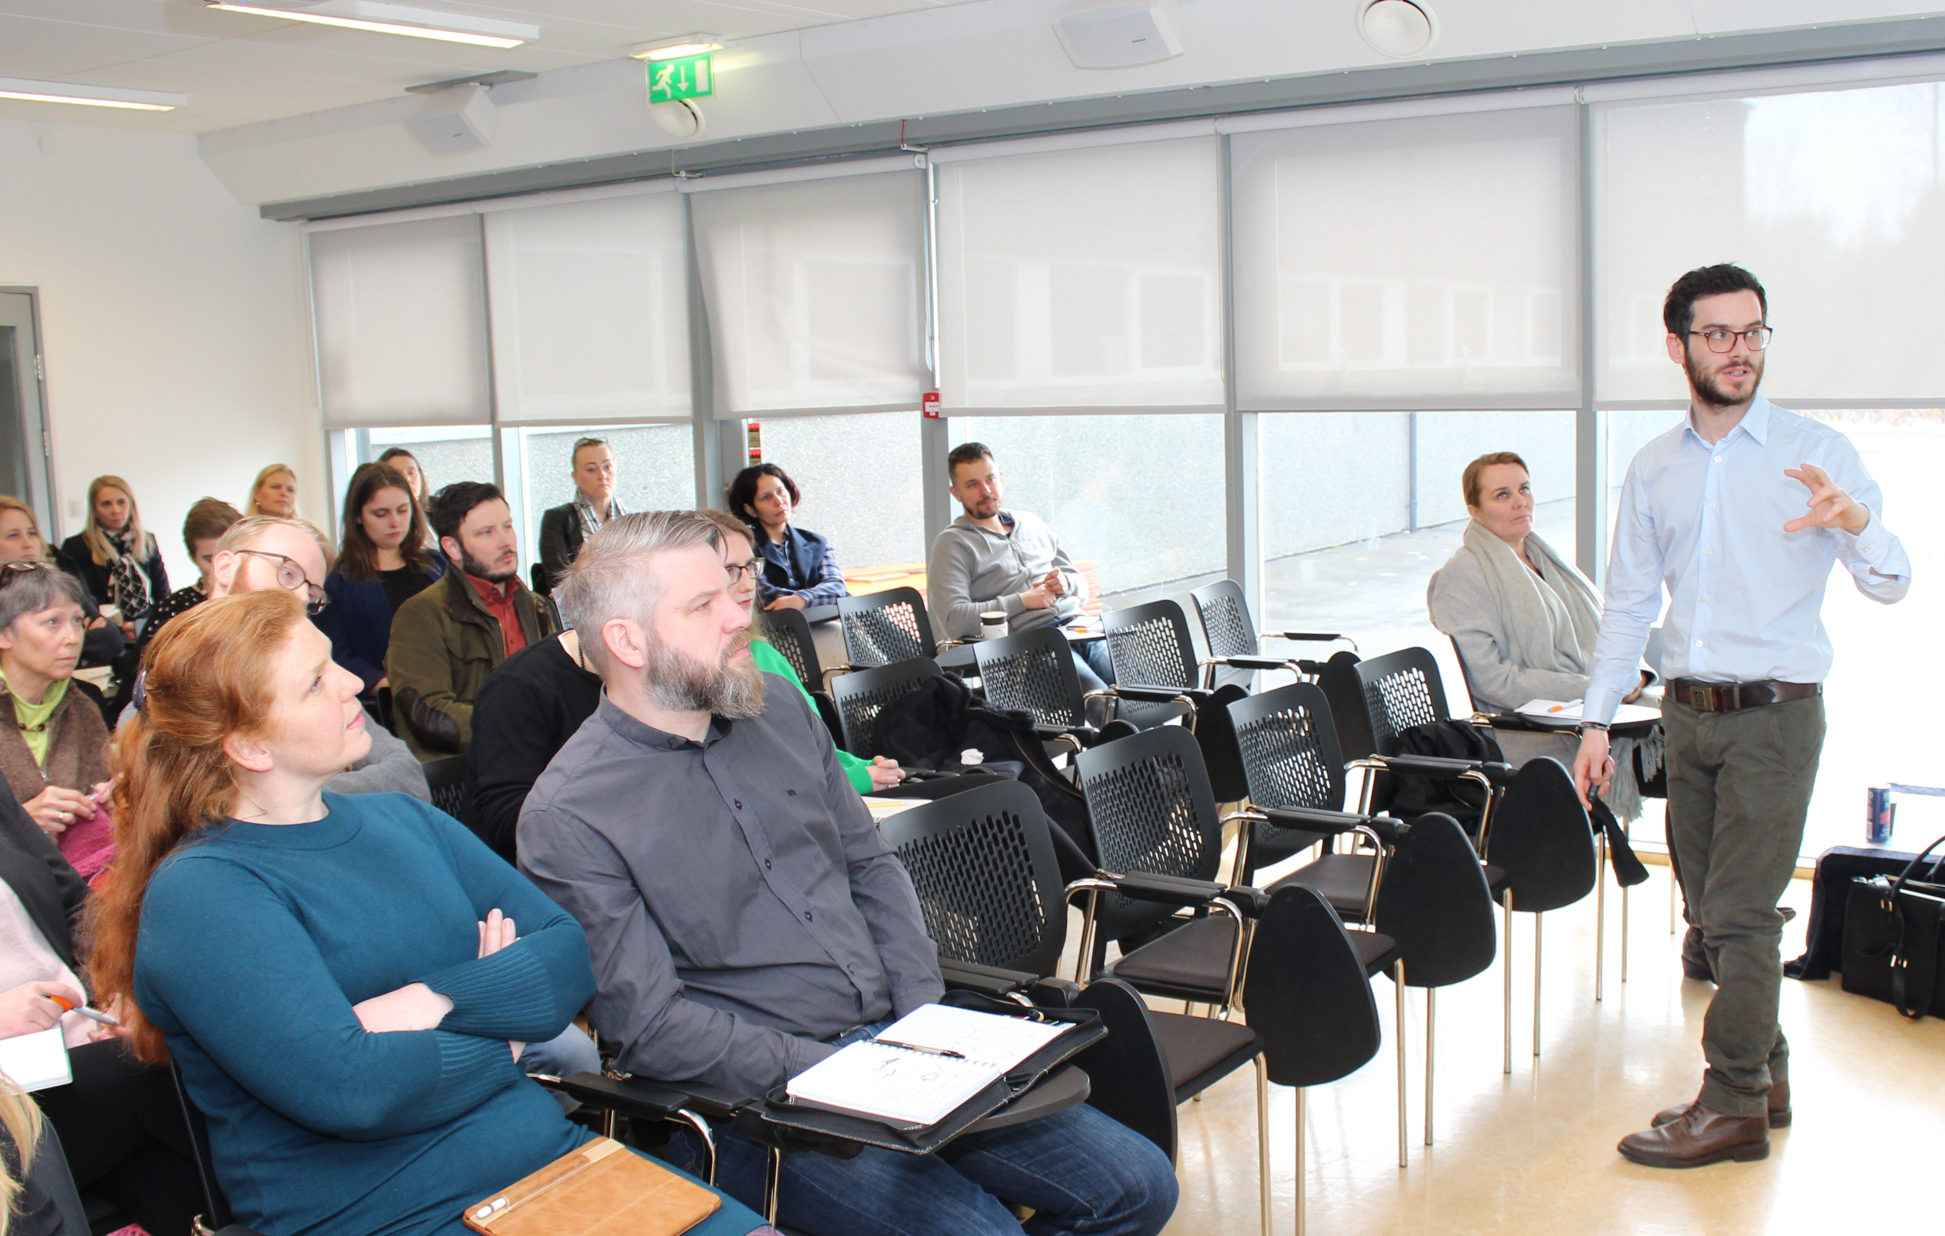
Entrepreneurs and SME services
Policy advice on support for innovation and improved operating conditions for SMEs
Publications on management, marketing, and more
The host for Enterprise Europe Network
  Boost growth and jobs through small businesses
  International network of companies
  Powerful databases and knowledge sharing

Slide 13
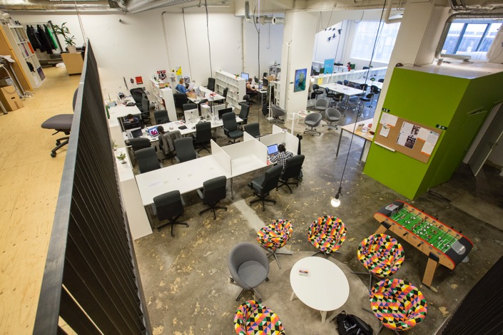
ICI Incubator Centers
Support and facilities for start-up companies working on innovative business ideas
Ten years experience at the original center in the Reykjavik headquarters
Increased focus on incubator centers
Innovation Center Iceland now operates 4 incubators but takes part in the operation of few others

Slide 14
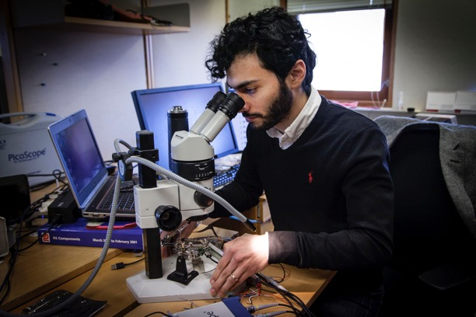
Interplay of research and support
The interplay of technological consulting and business support is our greatest strength.
A group of specialists in different fields encourage innovation and support the advantages of new ideas through research, development projects, business development and professional advice and consulting

Slide 15
The partner of choice for diverse projects
Innovation Center Iceland

